Slide 1

Customer Shopping Behavior Analysis
Uncovering insights from 3,900 purchases to guide strategic business decisions

Slide 2

Dataset Overview: A Glimpse into 3,900 Purchase Records
Our analysis delves into a comprehensive e-commerce dataset comprising 3,900 individual customer purchase records. This rich dataset provides a granular view of customer interactions and preferences, forming the bedrock of our strategic insights.
1
Total Purchases
An extensive collection of 3,900 distinct purchase events, offering a broad spectrum of customer activities.
2
Data Richness
Each record features 18 comprehensive columns, capturing a wide array of demographic and behavioral data points.
3
Data Completeness
Minimal missing values, with only 37 instances identified exclusively within the 'Review Rating' column, ensuring high data integrity.
4
Key Data Points
Includes detailed customer demographics (age, gender, location) and intricate behavioral data (purchase history, shipping preferences, discount usage).

Slide 3




Rigorous Data Preparation: Laying the Foundation for Insight
Our analytical journey began with meticulous data preparation, a critical phase that transformed raw data into actionable intelligence. This systematic approach ensures the reliability and accuracy of all subsequent findings.
Data Loading & Initial Exploration
Missing Value Handling
Utilized Python's powerful pandas library for efficient data loading. Conducted initial data exploration to understand the dataset's structure, identify data types, and generate summary statistics.
Strategically addressed missing values in the 'Review Rating' column by imputing with the median value, preserving statistical integrity and minimizing bias.
Feature Engineering
Database Integration
Enhanced the dataset by creating new features: age groups for demographic segmentation and purchase frequency to gauge customer engagement, unlocking deeper behavioral patterns.
Seamlessly integrated the prepared dataset into a robust database for SQL-based analysis, enabling complex querying and advanced data manipulation.

Slide 4
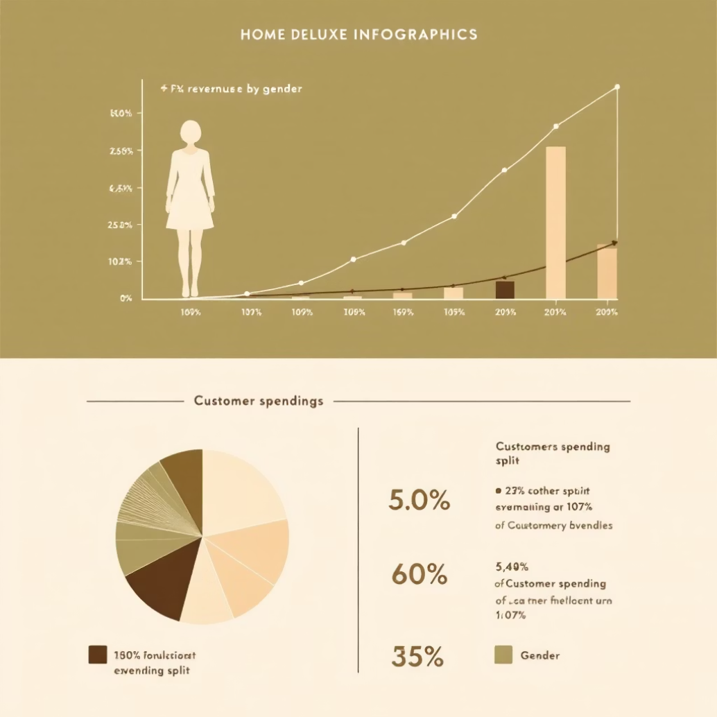

Revenue by Gender: Understanding Customer Value
A comparative analysis of total revenue generated by different genders reveals crucial insights into purchasing power and spending habits within our customer base. This understanding is vital for tailoring marketing efforts.
Our findings indicate that female customers generate a slightly higher total revenue compared to male customers. While the difference may not be drastic, it signifies a consistent trend in purchasing behavior that warrants strategic attention. This observation suggests that female customers, on average, contribute a larger share to the overall revenue stream.
This insight presents a significant business implication: the opportunity for enhanced gender-based marketing optimization. By understanding the specific product preferences, promotional sensitivities, and shopping patterns of female customers, we can craft more targeted and effective marketing campaigns. This could involve highlighting product categories popular among this demographic, personalizing offers, and refining messaging to resonate more deeply.
Conversely, it also prompts an investigation into strategies to increase engagement and revenue contribution from male customers, perhaps through different product assortments or marketing angles.
Key Insight:
Female customers consistently contribute a larger share to total revenue, indicating a valuable segment for focused marketing strategies.

Slide 5

Unlocking Value: The "Smart Shoppers" Who Leverage Discounts
Beyond general discount usage, we've identified a compelling segment: "Smart Shoppers." These customers strategically utilize discounts while consistently maintaining an above-average spend, representing a unique opportunity for premium engagement.
Discount Savvy
Above-Average Spend
Value Maximizers
These customers are proficient in using promotional offers and discount codes.
Despite using discounts, their overall transaction value remains significantly higher than the average customer.
They seek out deals but do not compromise on the quantity or quality of their purchases.
This group demonstrates that discounts, when offered to the right segments, can drive higher average order values rather than just attracting bargain hunters. The strategic opportunity lies in curating exclusive premium offers specifically for these high-value, discount-aware customers. By providing them with early access to sales, personalized bundles, or unique discount tiers on higher-priced items, we can reinforce their loyalty and further elevate their spending potential. Recognizing and rewarding these "Smart Shoppers" transforms a perceived cost (discounts) into a powerful driver of enhanced customer lifetime value.

Slide 6
Celebrating Excellence: Our Top-Rated Products
Customer satisfaction is a cornerstone of our business, and nothing reflects this more clearly than positive product reviews. Identifying our top-rated products not only highlights areas of success but also provides valuable insights for product development and marketing.
1
2
3
Product Alpha
Product Beta
Product Gamma
Consistently receives 5-star ratings for its innovative features and exceptional durability.
Praised for its user-friendly design and outstanding performance in diverse scenarios.
Highly acclaimed for its unique aesthetic and ability to exceed customer expectations.
These products exemplify customer satisfaction and product consistency. Their high average review ratings underscore our ability to deliver quality and meet consumer needs effectively. This information is invaluable for several reasons: it allows us to showcase these popular items in marketing campaigns, reinforcing trust and attracting new customers. It also provides a benchmark for other products, guiding improvements and ensuring that our entire product catalog strives for similar levels of excellence. By understanding what makes these products stand out, we can replicate success and further enhance our brand reputation.

Slide 7

Shipping Preferences: The Premium Value of Speed
The choice of shipping method offers a telling indicator of customer intent and perceived value. Our analysis reveals a distinct correlation between shipping preference and average purchase amount, highlighting the willingness of some customers to pay more for speed.
By comparing the average purchase amount for customers selecting Express Shipping versus Standard Shipping, a significant pattern emerges. Customers who choose faster delivery options demonstrate a propensity for higher spending. Specifically, our data indicates that express shipping customers spend around 12% more per transaction on average.
Key Insight:
Express shipping customers spend approximately 12% more per transaction than those opting for standard shipping.
This insight suggests that customers prioritizing speed are often those making larger, perhaps more urgent, or higher-value purchases. They perceive the convenience of rapid delivery as an integral part of their overall shopping experience and are willing to invest more for it. This understanding has important implications for our strategy:
Targeted Promotions: Develop premium product bundles or exclusive offers specifically for customers who frequently choose express shipping.
Service Enhancement: Continuously optimize our express shipping logistics to maintain competitive speeds and reliability, reinforcing the value proposition for these high-spending customers.
Messaging: Emphasize the speed and efficiency of express delivery in marketing materials for higher-value products.

Slide 8
Subscription Impact: Cultivating High-Value Loyalty
Subscription models are not merely about recurring revenue; they are powerful drivers of customer loyalty and increased lifetime value. Our data clearly illustrates the superior engagement and contribution of subscribers versus non-subscribers.
15%
25%
20%
Higher Average Spend
Increased Revenue Contribution
Enhanced Loyalty Rate
Subscribers demonstrate a significantly higher average spend per transaction compared to one-time purchasers.
A substantial portion of our overall revenue is directly attributable to our loyal subscriber base.
Subscribers exhibit a markedly higher retention rate, indicating stronger brand affinity and reduced churn.
The key insight is unequivocal: subscribers are our most valuable customer segment. They not only spend more on average but also contribute significantly more to our overall revenue and exhibit higher retention rates. This indicates a deep level of engagement and satisfaction that transcends a single purchase. Therefore, cultivating and expanding our subscriber base should be a top strategic priority. This includes focusing on acquisition strategies that convert non-subscribers, as well as retention efforts that reinforce the value proposition for existing members.

Slide 9
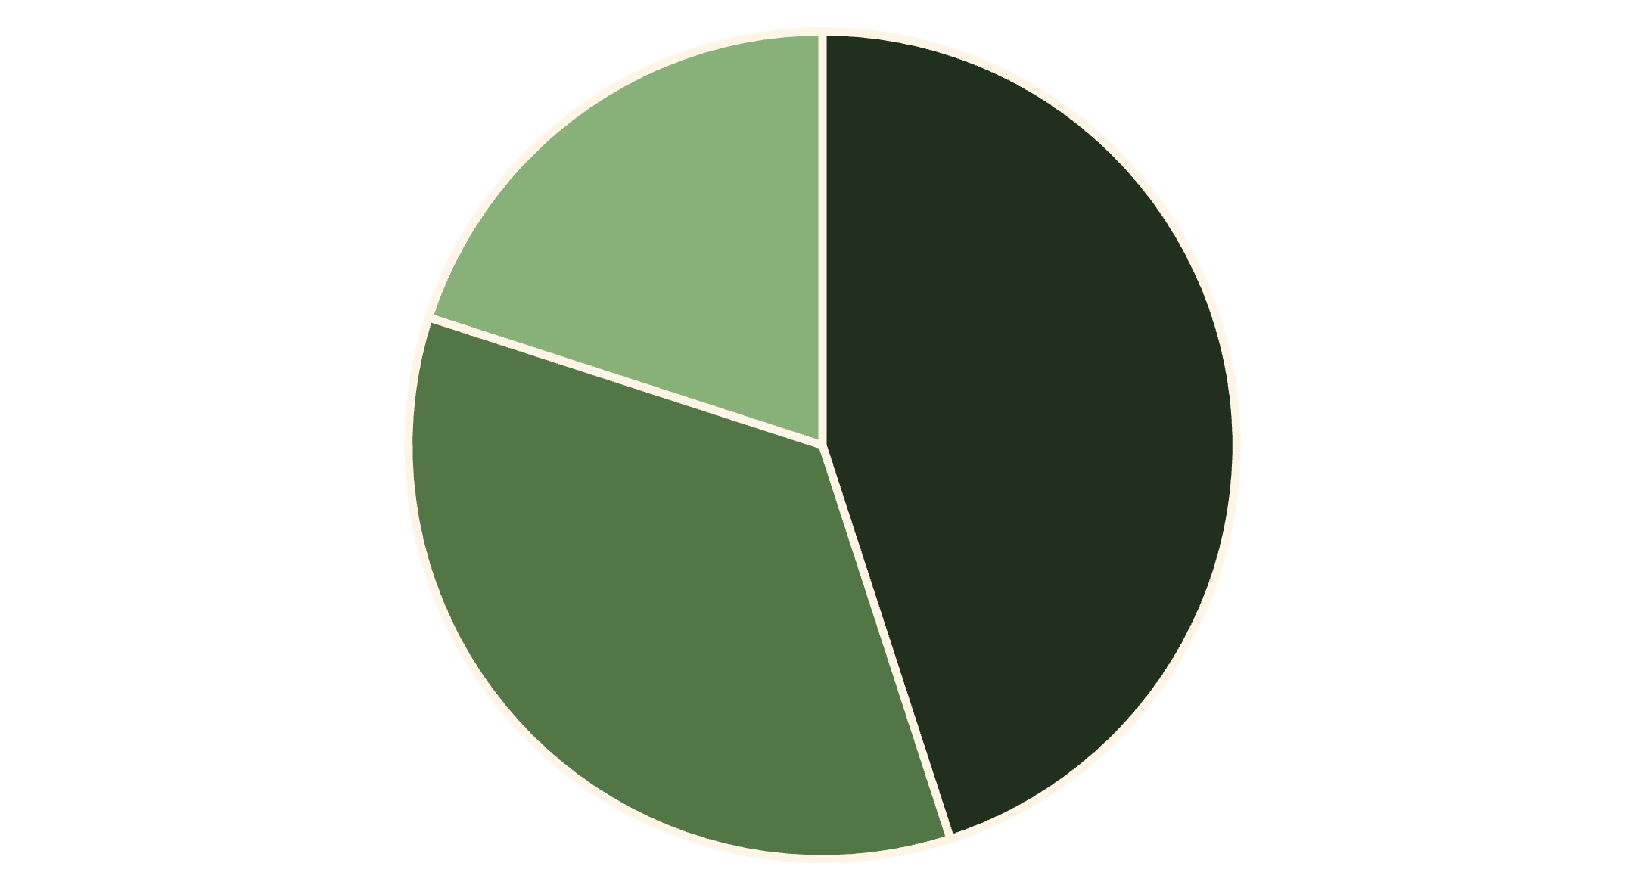
Customer Segmentation: Tailoring Engagement for Growth
Understanding our customer base means recognizing diverse behaviors and engagement levels. By segmenting customers into 'New,' 'Returning,' and 'Loyal,' we can craft targeted strategies to nurture their journey and maximize their lifetime value.
New Customers
Returning Customers
Loyal Customers
The segmentation reveals that New Customers constitute 45% of our base, followed by Returning Customers at 35%, and Loyal Customers at 20%. The critical insight here is the strategic imperative to focus on customer progression: moving new customers to returning, and returning customers to loyal status.
Each segment requires a distinct approach:
New Customers: Onboarding programs, welcome offers, and clear value proposition communication to encourage the second purchase.
Returning Customers: Personalized recommendations, loyalty program incentives, and feedback mechanisms to deepen engagement.
Loyal Customers: Exclusive benefits, VIP treatment, and community building to reinforce their advocacy and high-value contributions.

Slide 10
Strategic Recommendations: Driving Future Growth
Based on our comprehensive analysis, we propose a series of strategic recommendations designed to capitalize on identified customer behaviors, optimize marketing spend, and foster sustainable growth.
1
Boost Subscriptions Through Exclusive Benefits
2
Strengthen Loyalty Programs
Leverage the high-value nature of subscribers by offering unique perks such as early access to new products, members-only discounts, and enhanced customer service. Implement clear conversion pathways for one-time buyers.
Develop tiered loyalty programs that reward repeated purchases and engagement, encouraging customers to progress from 'New' to 'Loyal'. Gamification and personalized rewards can enhance participation.
3
Target High-Revenue & Express Shipping Users
4
Promote Top-Rated Products in Marketing Campaigns
Create bespoke marketing campaigns for "Smart Shoppers" and those preferring express shipping. Offer premium product suggestions, exclusive bundles, and VIP support to these high-spending segments.
Showcase our consistently high-performing products prominently across all marketing channels. Utilize social proof (reviews, ratings) to build trust and attract new customers to proven winners.
Implementing these recommendations will allow us to convert data-driven insights into tangible business growth, optimizing customer lifetime value and solidifying our market position.

